Slide 1
Data Mining
Anomaly Detection
Lecture Notes for Chapter 10
Introduction to Data Mining
by
Tan, Steinbach, Kumar
© Tan,Steinbach, Kumar Introduction to Data Mining 4/18/2004 <number>

Slide 2
Anomaly/Outlier Detection
What are anomalies/outliers?
  The set of data points that are considerably different than the remainder of the data
Variants of Anomaly/Outlier Detection Problems
  Given a database D, find all the data points x ∈ D with anomaly scores greater than some threshold t
  Given a database D, find all the data points x ∈ D having the top-n largest anomaly scores f(x)
  Given a database D, containing mostly normal (but unlabeled) data points, and a test point x, compute the anomaly score of x with respect to D
Applications:
  Credit card fraud detection, telecommunication fraud detection, network intrusion detection, fault detection

Slide 3
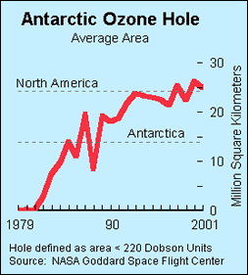
Importance of Anomaly Detection
Ozone Depletion History
In 1985 three researchers (Farman, Gardinar and Shanklin) were puzzled by data gathered by the British Antarctic Survey showing that ozone levels for Antarctica had dropped 10% below normal levels
Why did the Nimbus 7 satellite, which had instruments aboard for recording ozone levels, not record similarly low ozone concentrations?
The ozone concentrations recorded by the satellite were so low they were being treated as outliers by a computer program and discarded!
Sources:
http://exploringdata.cqu.edu.au/ozone.html
http://www.epa.gov/ozone/science/hole/size.html

Slide 4
Anomaly Detection
Challenges
  How many outliers are there in the data?
  Method is unsupervised
    Validation can be quite challenging (just like for clustering)
  Finding needle in a haystack
Working assumption:
  There are considerably more “normal” observations than “abnormal” observations (outliers/anomalies) in the data

Slide 5

Anomaly Detection Schemes
General Steps
  Build a profile of the “normal” behavior
    Profile can be patterns or summary statistics for the overall population
  Use the “normal” profile to detect anomalies
    Anomalies are observations whose characteristics
    differ significantly from the normal profile
Types of anomaly detection
schemes
  Graphical & Statistical-based
  Distance-based
  Model-based

Slide 6
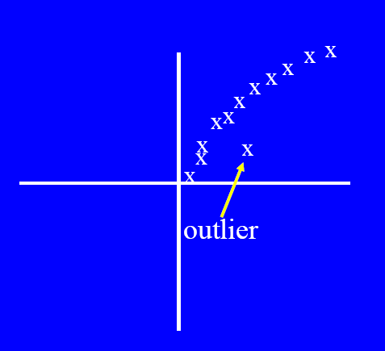
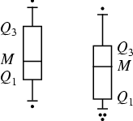
Graphical Approaches
Boxplot (1-D), Scatter plot (2-D), Spin plot (3-D)
Limitations
  Time consuming
  Subjective

Slide 7
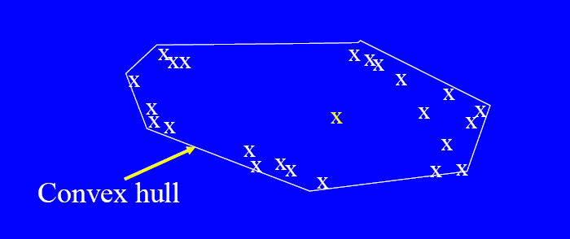
Convex Hull Method
Extreme points are assumed to be outliers
Use convex hull method to detect extreme values
What if the outlier occurs in the middle of the data?

Slide 8

Statistical Approaches
Assume a parametric model describing the distribution of the data (e.g., normal distribution)
Apply a statistical test that depends on
  Data distribution
  Parameter of distribution (e.g., mean, variance)
  Number of expected outliers (confidence limit)

Slide 9
Statistical-based – Likelihood Approach
Assume the data set D contains samples from a mixture of two probability distributions:
  M (majority distribution)
  A (anomalous distribution)
General Approach:
  Initially, assume all the data points belong to M
  Let L_{t}(D) be the log likelihood of D at time t
  For each point x_{t} that belongs to M, move it to A
    Let L_{t+1} (D) be the new log likelihood.
    Compute the difference, Δ = L_{t}(D) – L_{t+1} (D)
    If Δ > c (some threshold), then x_{t} is declared as an anomaly and moved permanently from M to A

Slide 10
Limitations of Statistical Approaches
Most of the tests are for a single attribute
In many cases, data distribution may not be known
For high dimensional data, it may be difficult to estimate the true distribution

Slide 11
Distance-based Approaches
Data is represented as a vector of features
Three major approaches
  Nearest-neighbor based
  Density based
  Clustering based

Slide 12
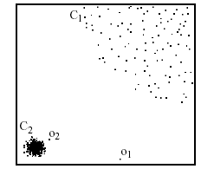
Nearest-Neighbor Based Approach
Approach:
  Compute the distance between every pair of data points
  Various ways to define outliers:
    Points with very few neighbors (defined by distance)
    Points with top highest distances to their kth nearest neighbor
    Points with top highest average distance to the k nearest neighbors
p₂
×
p₁
×

Slide 13
Density-based: LOF approach
For each point, compute the density of its local neighborhood
Compute local outlier factor (LOF) as the ratio of density of a sample to that of its nearest neighbors
Outliers are points with lowest LOF value
Question:
Can nearest neighbor method detect P2 outlier?
Can LOF method detect P2 outlier?
p₂
×
p₁
×

Slide 14
Clustering-Based
Basic idea:
  Cluster the data into groups of different density
  Choose points in small cluster as candidate outliers
  Compute the distance between candidate points and non-candidate clusters.
    If candidate points are far from all other non-candidate points, they are outliers

Slide 15
Supervised Method
When there are sufficient outlier samples
Train a model between normal objects and outliers
What are the advantage and disadvantage of this approach, compared with previous approaches?

Slide 16


Base Rate Fallacy
Bayes theorem:
More generally:

Slide 17
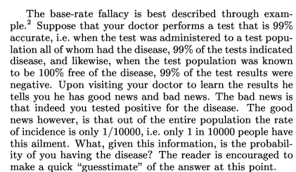
Base Rate Fallacy (Axelsson, 1999)

Slide 18


Base Rate Fallacy
Even though the test is 99% certain, your chance of having the disease is 1/100, because the population of healthy people is much larger than sick people

Slide 19
Base Rate Fallacy in Intrusion Detection
I: intrusive behavior,
¬I: non-intrusive behavior
A: alarm
¬A: no alarm
Detection rate (true positive rate): P(A|I)
False alarm rate: P(A|¬I)
Goal is to maximize both
  Bayesian detection rate, P(I|A)
  P(¬I|¬A)

Slide 20



Detection Rate vs False Alarm Rate
Suppose:
Then:
False alarm rate becomes more dominant if P(I) is very low

